Slide 1


Slide 2
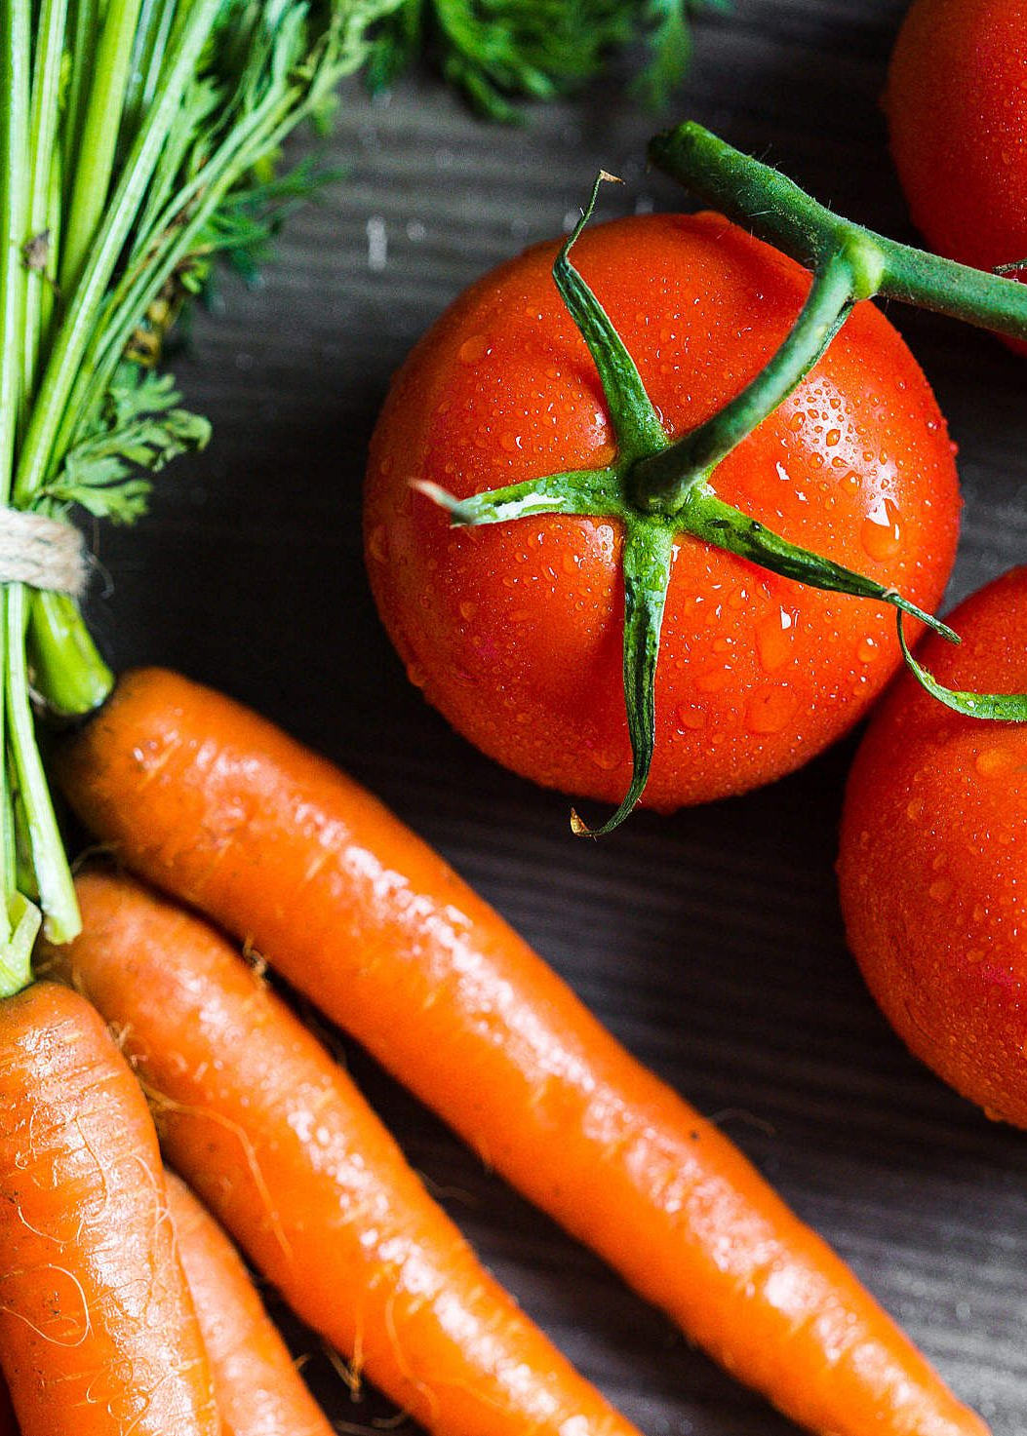
Vegetables Classification: Capsicum, Tomato, and Carrot
Computer vision can help us classify and identify different vegetables.

Slide 3
Group Members
Abdullah Khalid
SP19_BCS_141
Ayesha Bibi
SP20_BCS_152
Abdullah Waheed
SP20_BCS_043

Slide 4
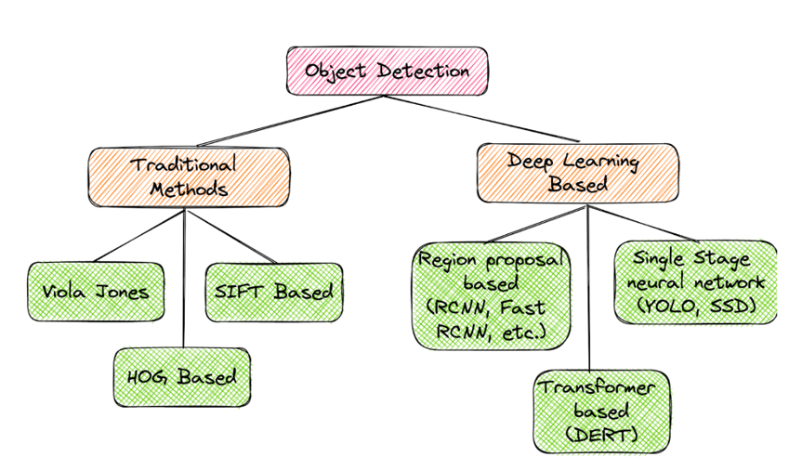
Techniques in Computer Vision

Slide 5
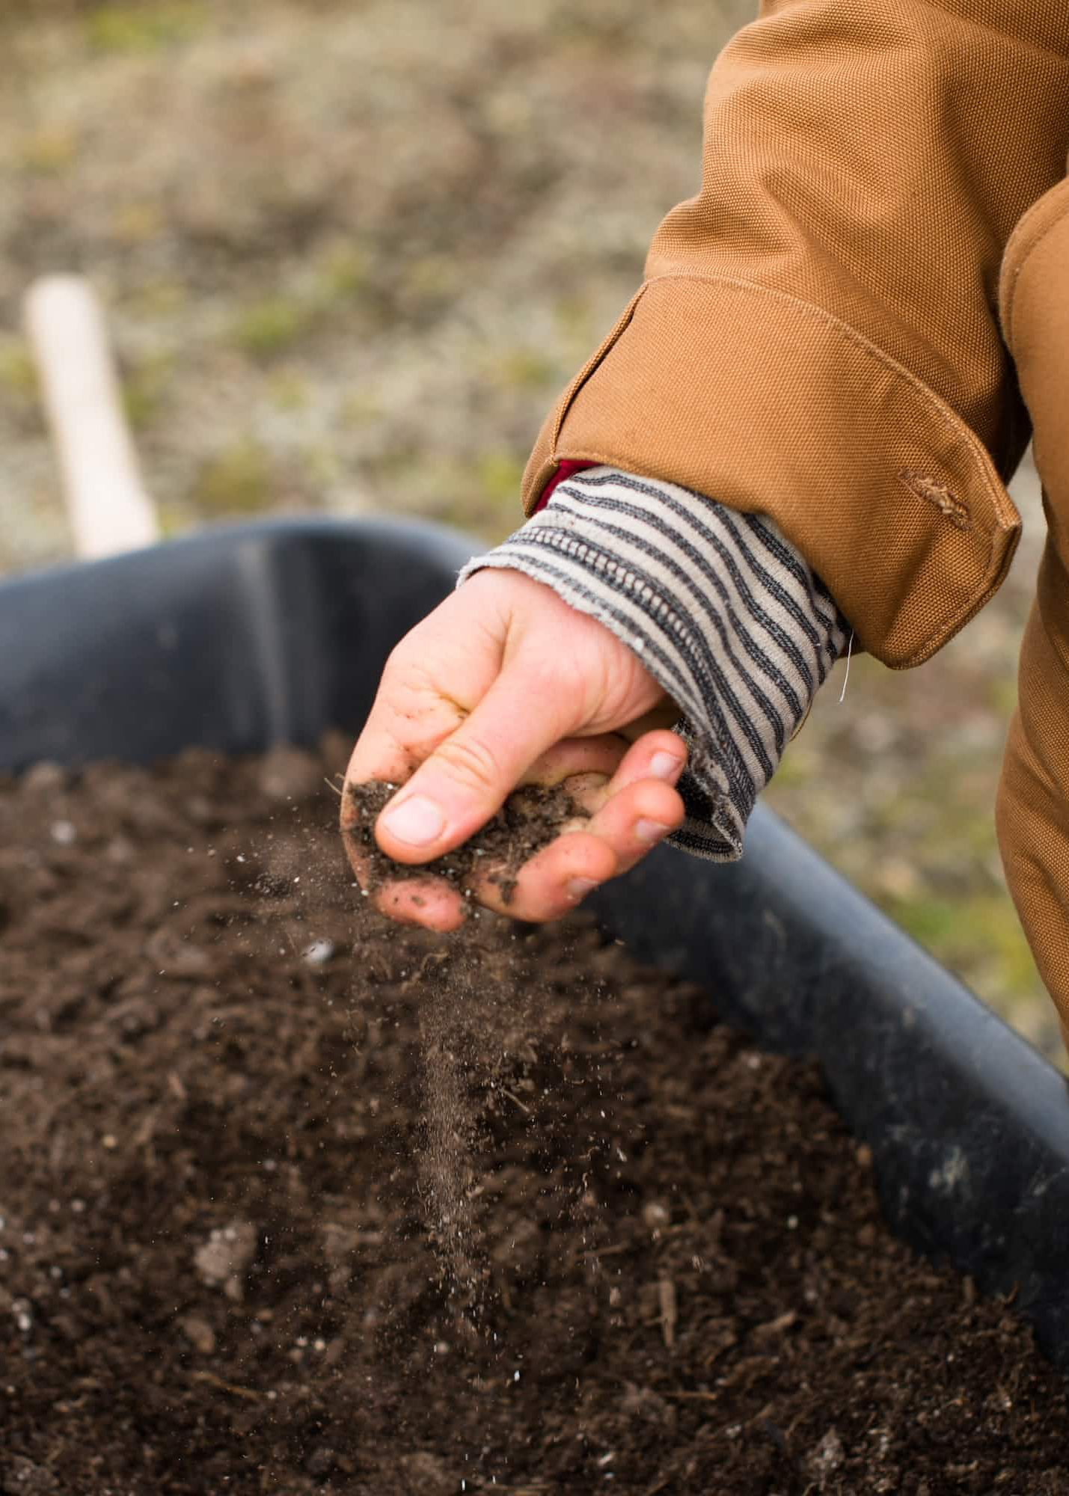
Problem
Manually analyzing the quality and classification is hectic for farmer considering the huge amount of vegetables…
Need assistance for that so the Computer vision technique will accurately detect the class of vegetable

Slide 6
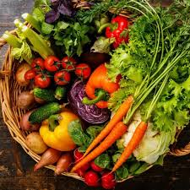
Proposed Solution
The purposed solution has the potential to assist farmers to be more efficiently and accurately diagnose the class of different vegetables on a large scale Automation in detecting the different classes of vegetables by using the deep learning algorithms

Slide 7

Dataset Preparation
We have downloaded a part of huge dataset from the internet.
https://housing.com/news/capsicum-plant-how-to-grow-and-care-for-capsicum-annum/
https://patch.com/massachusetts/sharon/storm-bruised-tomatoes-still-useful-in-dishes

Slide 8
Dataset Preparation
Data was balanced by augmentation as:
Classes | No of Images
Carrot | 150
Tomato | 150
Capsicum

Slide 9
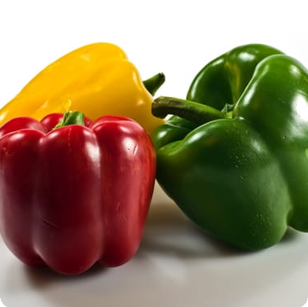
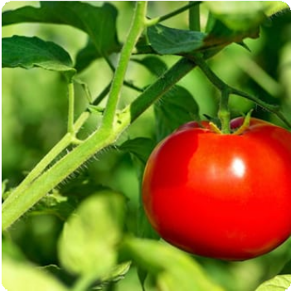
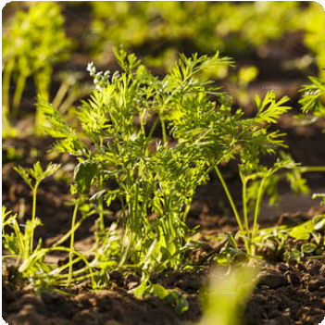
Data Set Preparation
Capsicum
We collected images of capsicum from different angles and lighting conditions to create a diverse data set and collect this data from google images, different website.
Tomato
Our tomato data set included pictures of tomatoes on different vegetables, separate.
Carrot
We captured images of carrots in their natural environment.

Slide 10

Dataset Labeling
We have used Roboflow tool for labeling:
https://universe.roboflow.com/cv-hd3yc/vegetable-finder

Slide 11
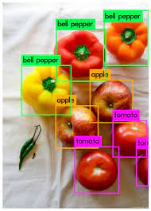
Dataset Augmentation
Our Data was augmented by
Changing the brightness of images
Changing the dimension of images
1) Flip (Horizontal and Vertical)
2) Rotation -15 to +15

Slide 12
Why Dataset Augmentation is important?
It increases the model's ability to generalize.
It adds variability to the data and minimizes data overfitting.
It improves the accuracy of the deep learning model's predictions.

Slide 13
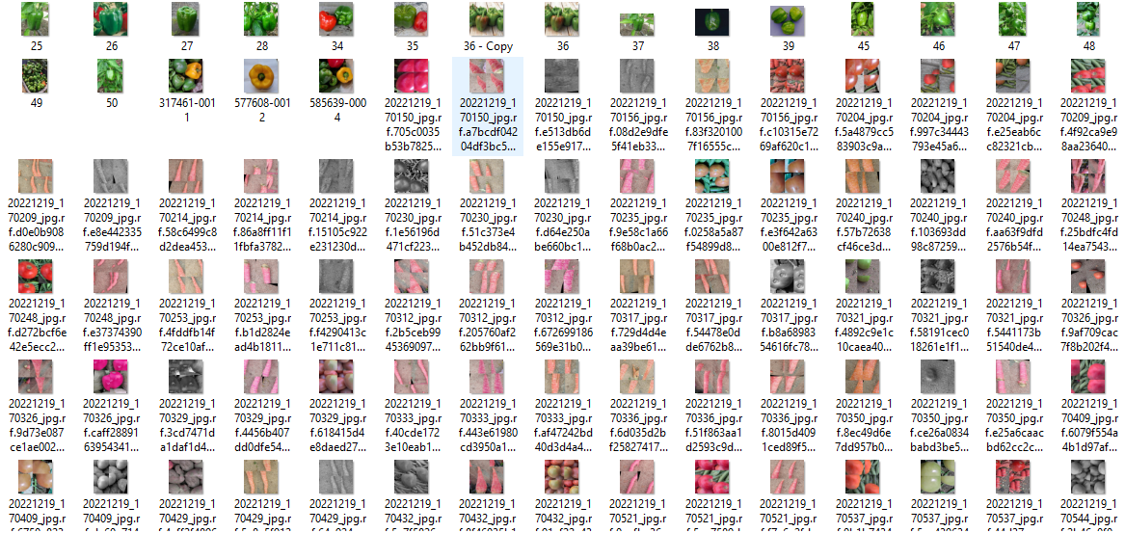
Dataset Augmentation

Slide 14
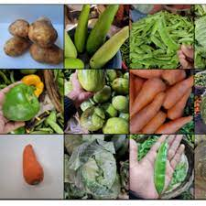
Dataset Splitting
For Training, 70% images with their labels are used
For Testing, 10% images with their labels are used
For Validation, 20% images with their labels are used

Slide 15
Continue…
Our dataset is prepared
Now, It is ready for the Training!

Slide 16
Model Training & Evaluation
Training
We used a transfer learning to train our model and iteratively improve our results.
1
2
3
Preprocessing
We used the Roboflow tool to resize and normalize all our images.
Validation
We tested our model on a separate set of images to ensure it was accurately identifying capsicum, tomato, and carrot.

Slide 17

Benefits of Computer Vision
Computer vision can revolutionize the food industry by improving the quality of produce and reducing food waste. It can also be used in security, robotics, and healthcare to analyze data and improve decision- making.

Slide 18

Real World Applications
1
Food Industry 🍎
Computer vision can help improve the quality of crops, reduce waste, and lower costs for farmers and grocery stores.
2
Security 🔒
It can be used to analyze and interpret data from surveillance cameras and improve threat detection.
3
Healthcare 🩺
Computer vision can help analyze medical images, identify diseases, and improve patient care.

Slide 19


Do you have any questions?

